Slide 1


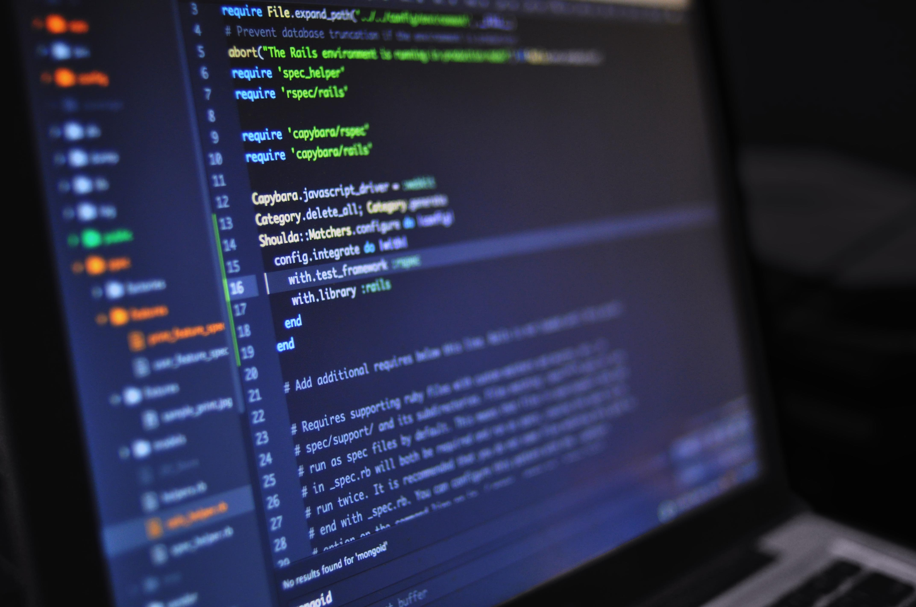
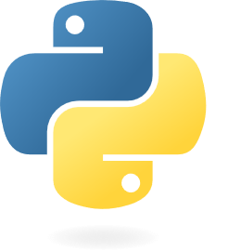

Lesson 04:
Libraries : Pandas library
Introduction to Pandas library
Cleaning Data
Correlation
Data Cleaning techniques
Python for beginners
with applications
Write code from scratch in a clear & concise way, through a complete basic course.
From beginners to intermediate.
Abdesselam Filali 2026-02-22 13h30 Algiers time

